Slide 1
Section 9
Thursday Nov 30th

Slide 2
Announcements
HW 7 due Tuesday (12/5) @ 11:59pm
Learning Reflection 8 due tomorrow (Fri, 12/1) at 11:59pm

Slide 3
Agenda
Neural Networks Recap
Structure
Training
CNNs
PyTorch demo on COLAB

Slide 4
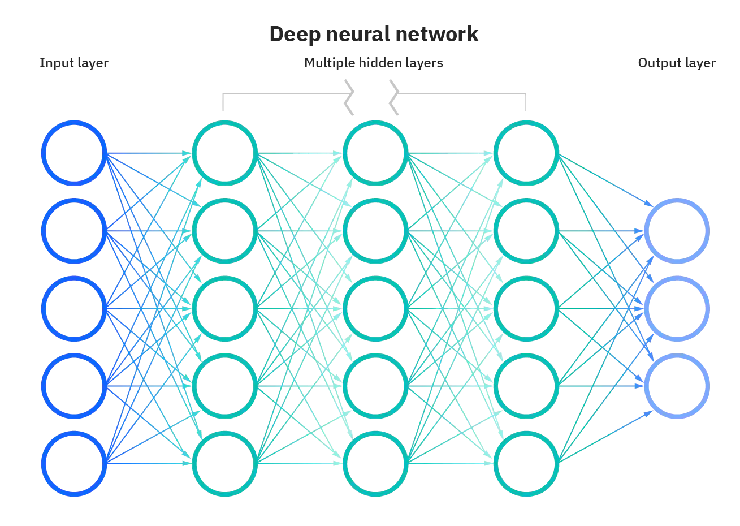
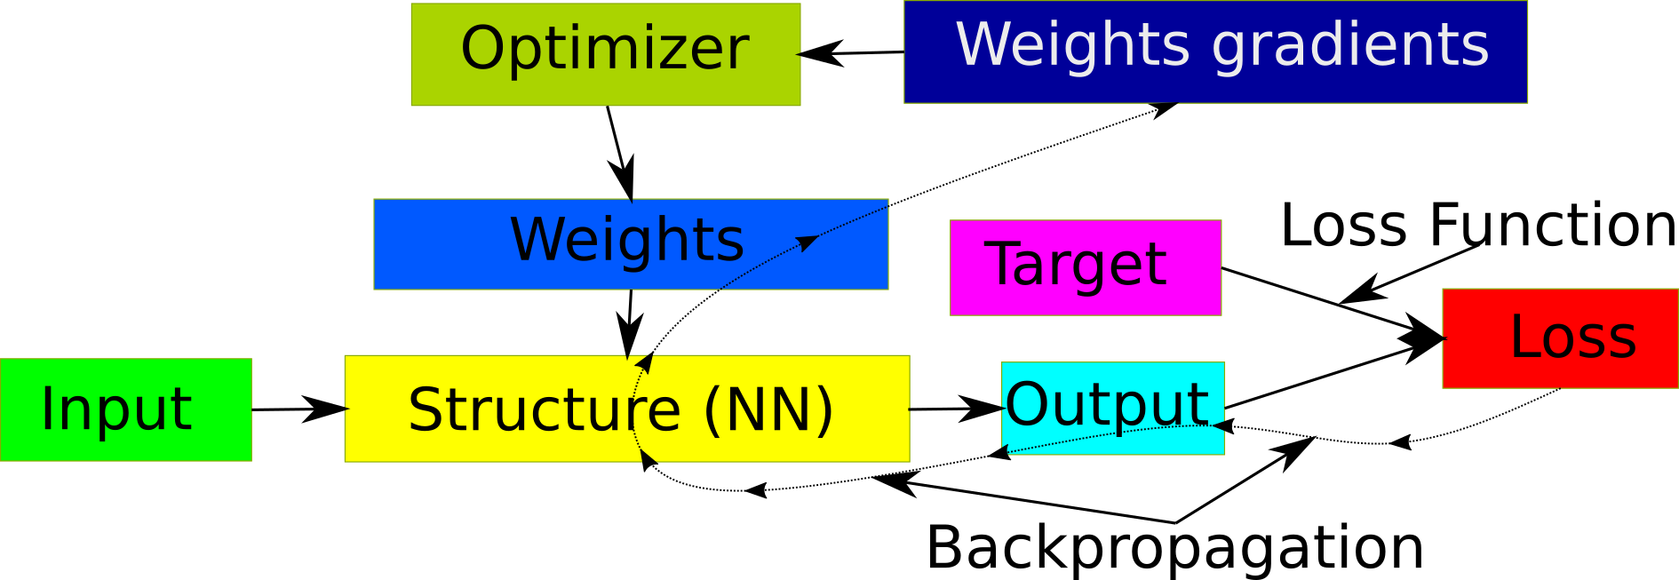
Neural Networks Components
Structure
Loss Function
Backpropagation
Optimizer
Training

Slide 5
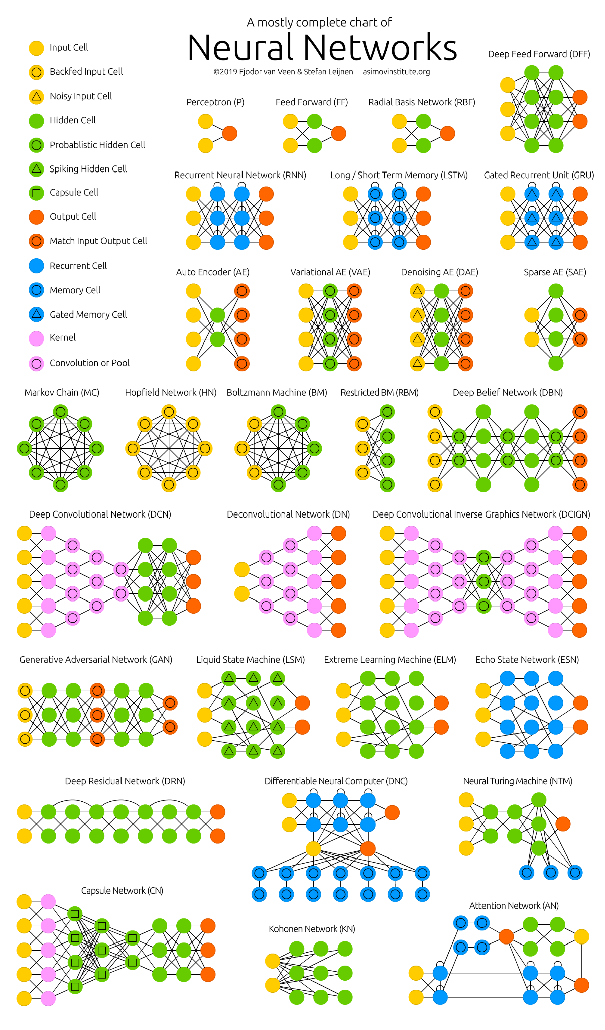
Neural Networks Structure
Many topologies depending on application (see picture)
NN transforms an input vector to an output vector
Layers (number, sizes, types)
Activation functions
Extremely large number of parameters (millions to billions)
Large number of hyperparameters
Hyperparameter tuning very important
Notes:
Hyperparameters include, number, sizes and types of hidden layers, as well as activation functions

Slide 6
Loss Function
Defines how to penalize errors
Combines Output and Target
L2, L1 for numeric targets
Cross-entropy for classification

Slide 7
Backpropagation
Computes the gradient of the Loss w.r.t. Weights
The backbone of Neural Network training
Traverses computational graph backwards and uses chain rule from calculus

Slide 8
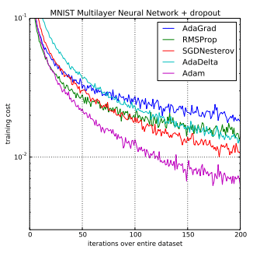
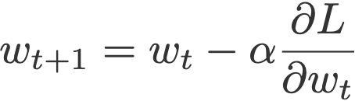
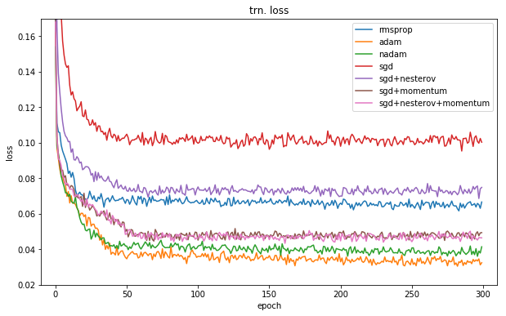
Optimizer
Updates the weights, using the gradients
Can use Momentum to speed up optimization (top pic) or achieve lower loss (bottom)
Adam is most widely used
Not very sensitive to learning rate

Slide 9
Optimizers
comparison

Slide 10
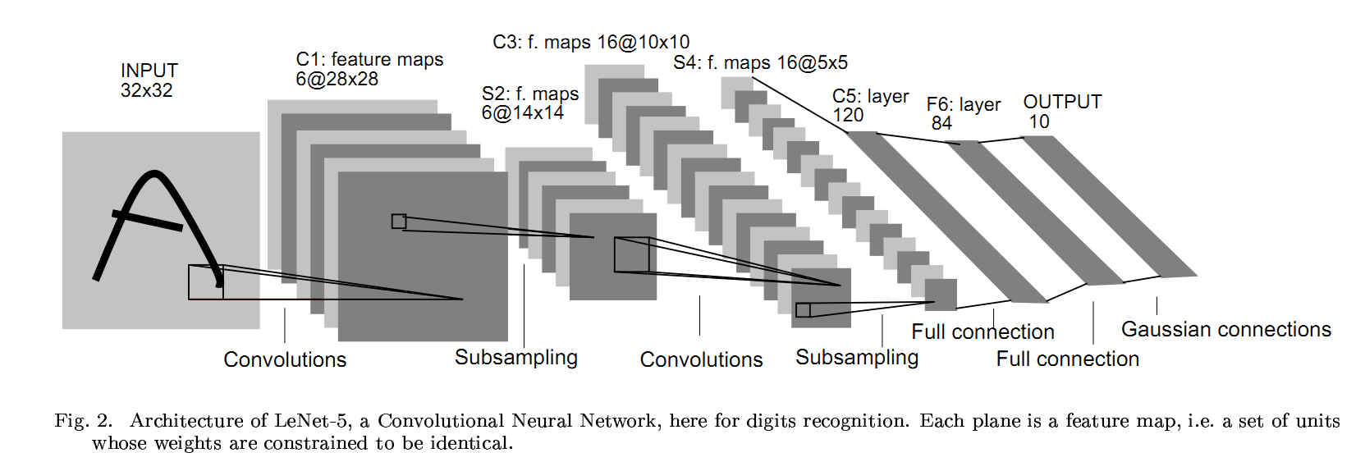
Convolutional Neural Networks
Used with image inputs (HxWx3)
Height, width, number of channels
Each layer transforms the input image
Smaller size and larger number of channels
Channels represent higher order features
Example:
To go from 3 channels to 7 channels using kernels of size 5x5 we would use a tensor of size 7x3x5x5 (525 parameters)
Eventually we finish with an image of size 1x1xC and use fully connected layers

